Slide 1

Workflow Management Game
Chris DAWSON, ben Coxford, callum campbell

Slide 2

Introduction

Slide 3

Group Info
Group Number: 3
Group Name: We’re group 3…
Concept Title: Workflow Management Game
Group Goal: To develop a solution to a business problem using project management and agile SCRUM methodology. Focus on developing our soft skills.

Slide 4
Business Concept

Slide 5
Workflow Management Game
We wanted to create a workflow management game to allow managers to improve their resource and time management skills in a factory scenario.
We took an example of a Lego factory creating sets and how various factors can effect the businesses reputation, sales and profits.

Slide 6
Group Roles

Slide 7
Group Roles
Each sprint (week), one of us took on the role of SCRUM master as we followed a rota. The other two would be programmers and we would all follow a backlog of tasks for the week.
Every Friday we conducted a SCRUM meeting either in person or over Discord.
The SCRUM master would delegate tasks and update our Trello board as shown on the next slide.

Slide 8
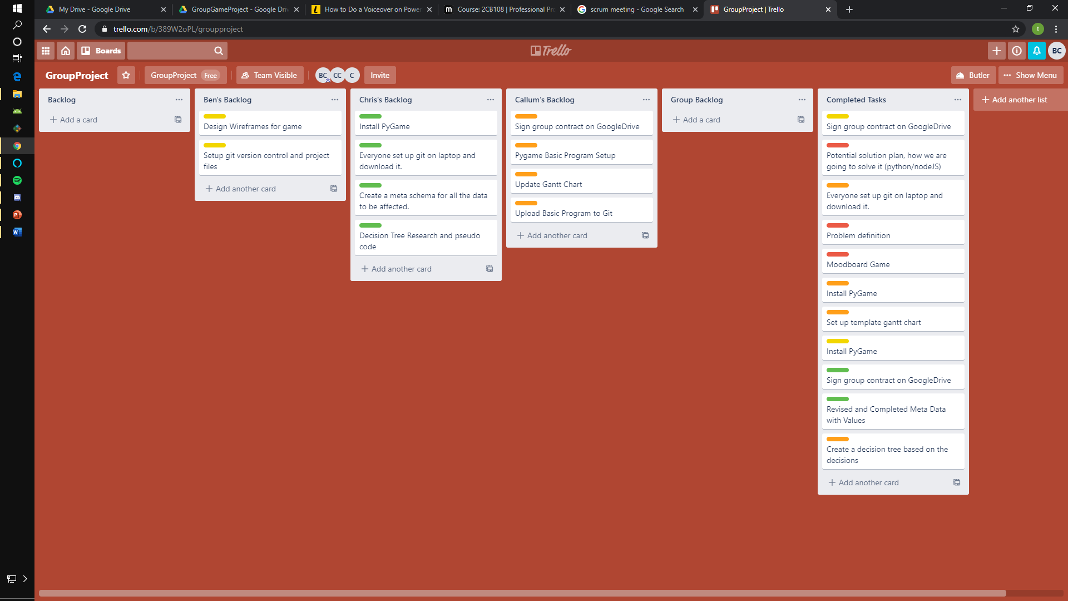
Trello Example

Slide 9
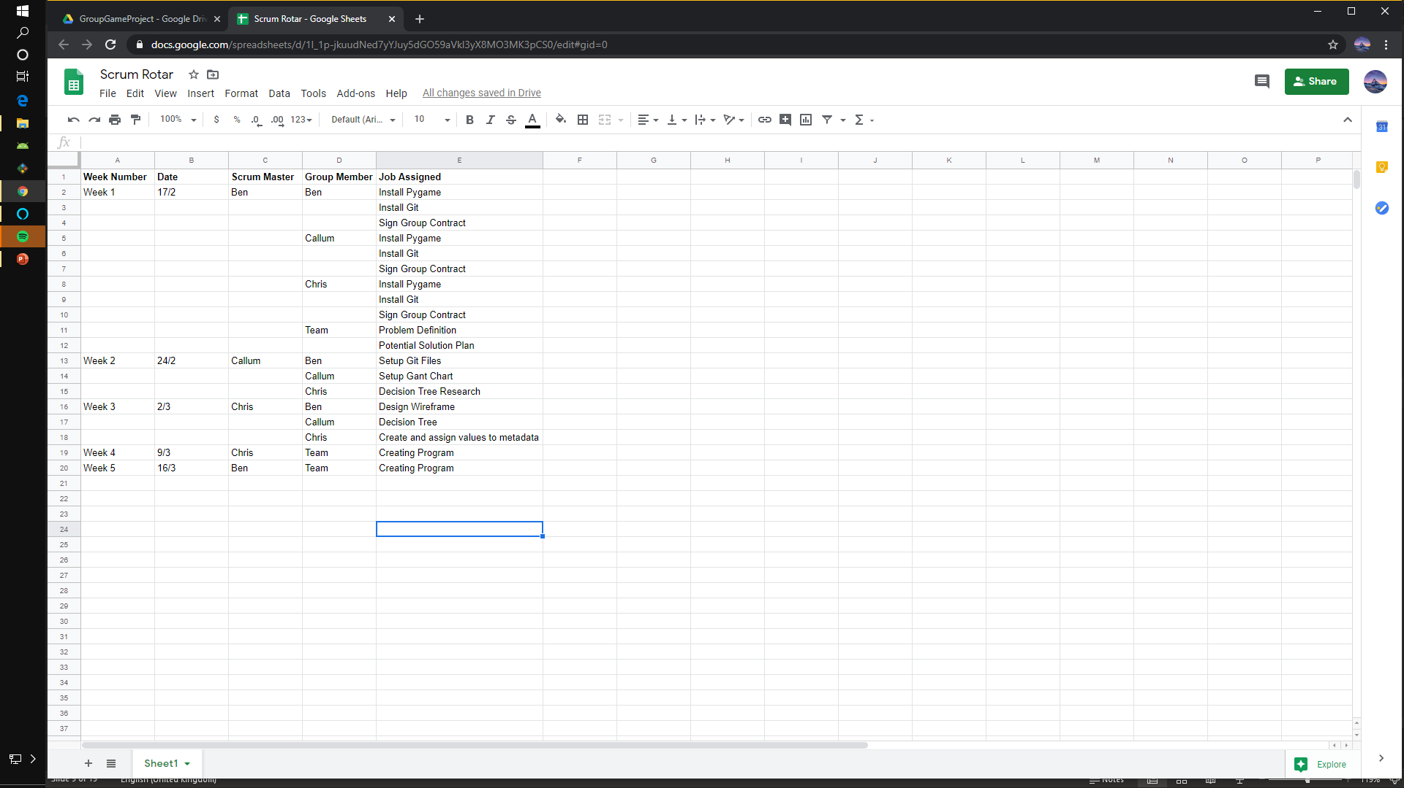
SCRUM Master Rota
Weekly sprints

Slide 10
Agile PM

Slide 11
Agile Project Management
We used Scrum to collaborate on this project. We were each assigned specific weeks to be the scrum master and control the tasks for that week. We used Trello to communicate the distribution of tasks.

Slide 12

Technology

Slide 13
Python
Almost immediately the group agreed that python would perfect for this project by using the PyGame framework we would be able to make a simple but effective game that would allow us to include graphics and sound libraries.

Slide 14
PyGame
Pygame is a SDL library (Simple DirectMedia Layer) which interfaces with the systems hardware such as sound or a joystick. It allows the development of games in Python.

Slide 15
Our Contributions

Slide 16
Ben
Setting out group contract
Create case study/scenario
Create and implement wireframes
Setup initial pygame file
Setup Git Location
Programming

Slide 17
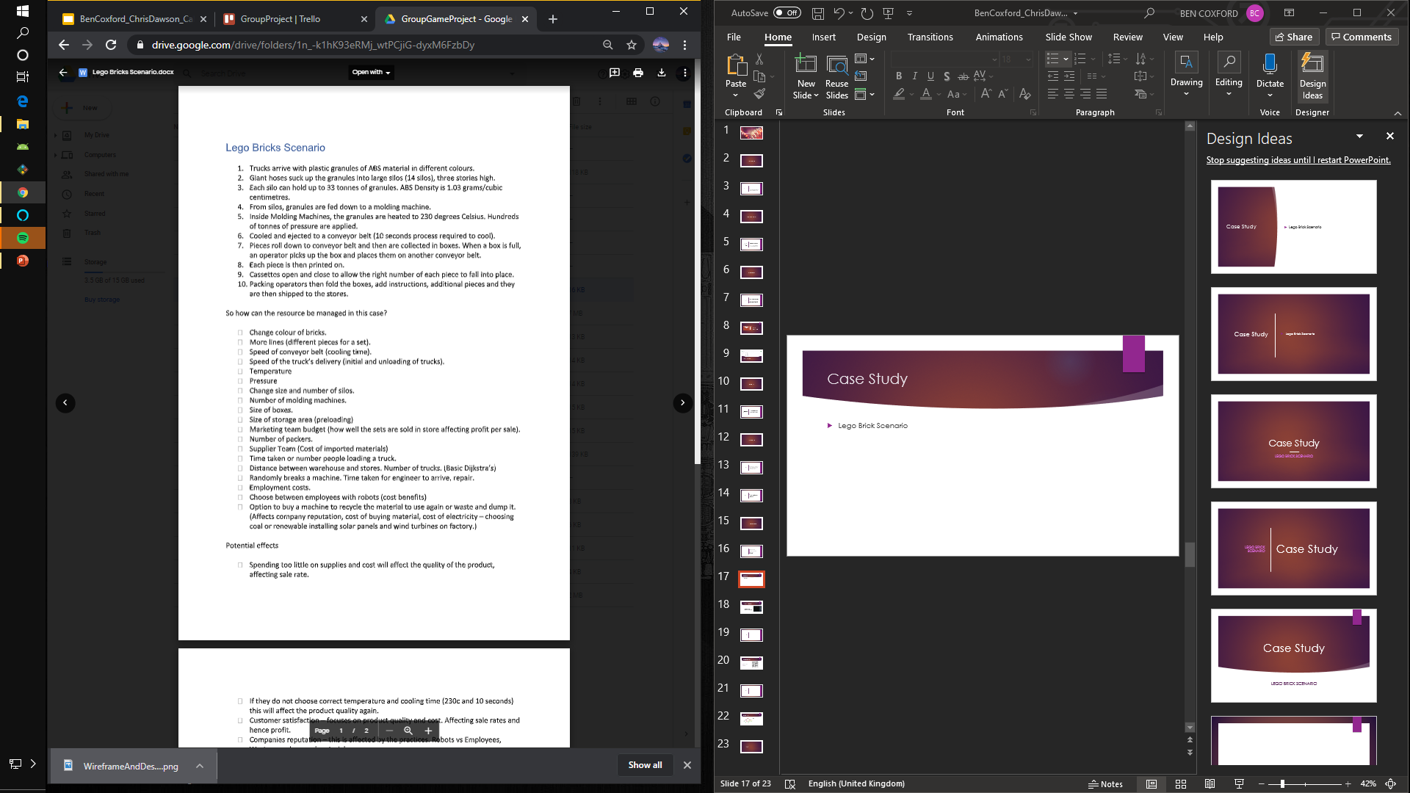
Case Study
Lego Brick Scenario
This was our scenario we chose in a Lego brick factory. The effect temperature and pressure affected the quality and overall sales of the product. You needed to find the optimum values for the best quality at a trade-off.
Each scenario has a trade off. I.e. changing to robots instead of having employees increased your output at a cost to the companies reputation.

Slide 18
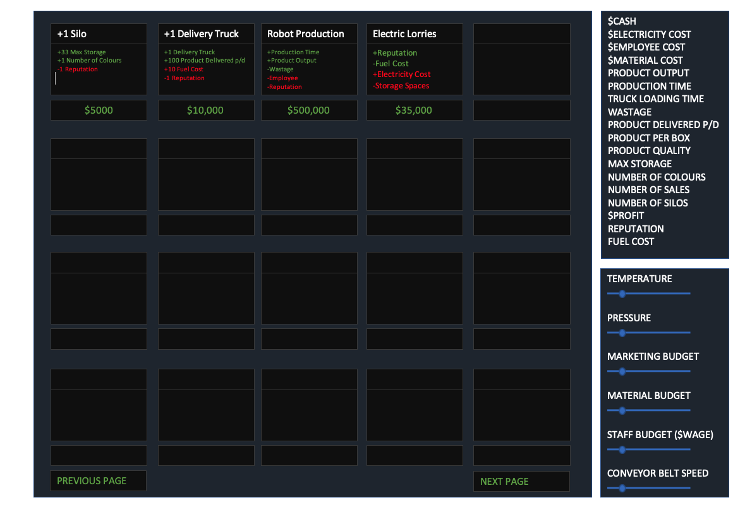
Wireframe and Design
Simple yet effective design. Showing each level, the advantages and disadvantages of the managerial change.
Based on statistics and a report-like form.

Slide 19
Programming
I had setup the games core itself, focusing on producing a prototype user-interface and then set out outlining the specific functions.
Afterwards, both Chris and Callum completed several of the games functions, with Chris also programming all of the data from the metaschema.

Slide 20

Chris
Decision tree research
Create and assign metadata values
Programming

Slide 21
Meta Data Schema
Variable | Increase Outcome | Increase Cost/Gain | Decrease Outcome | Decrease Cost/Gain
Number of Lines | Greater volume of product created | Cost £, More electricity required | Lower volume of product created | Small refund £, Less electricity required
Speed of conveyor belt | Reduced production time | Cost £ | Cannot downgrade | Cannot downgrade
Speed of delivery truck | More materials per day | Cost £ | Cannot downgrade | Cannot downgrade
Temperature | Produces brick more quickly | Costs more electricity, Costs quality | Produces brick more slowly, higher quality | Costs less electricity, Costs time
Pressure | Produces brick more quickly | Costs more electricity, Costs quality | Produces brick more slowly | Costs less electricity, costs time, gain quality
Number of silos | Greater material storage capacity | Cost £ | Cannot downgrade | Cannot downgrade
Size of boxes | More product per box | Cost £ per month | Less product per box | Costs less £
Size of storage | Greater number of boxes stored | Cost £ | Cannot downgrade | Cannot downgrade
Marketing Budget | Increase in sales | Cost £ per month | Decrease in sales | Cost less £
Number of Packers | Faster truck loading time | Cost £ per month | Slower truck loading time | Cost less £
Material sourcing team budget | Cheaper Materials | Costs quality, costs £ per month | Higher quality product | Materials cost more £
Number of delivery trucks | Greater quantity of product can be delivered | Cost £ per month | Lower quantity of product can be delivered | Decreased cost
Human to Robot worker upgrade | Greater brick production and truck loading speed | Lower Cost, costs reputation | Cannot downgrade | Cannot downgrade
Waste machine | No waste | Costs £, Increased reputation | Cannot downgrade | Cannot downgrade
Purchase wind/solar power | No effects on production | Increase in electricity, increase in reputation, Cost £ | No effects on production | Small refund, decreased electricity, decreases reputation
The meta data schema was to help plan and setup how levels progressed and affected the statistics.

Slide 22
Callum
Creating gantt chart
Creating decision tree
Programming

Slide 23
How far we got and errors
We got the basics of the game up and running.
There are a few errors.
The levels and effects do not update.
The statistics do not show other than the Cash.
To develop it further we would fix these to produce a more enjoyable game.
Covid-19

Slide 24
Play it
LINK: https://git.yorkdc.net:8888/ben.coxford/gameproject
Download and clone the file named PyGameFactoryGameGroup3.py.
Use: git clone <link> in cmd.
You must have Python and Pygame installed.

